Slide 2
Tracheostomy
دكتر اصغري
فوق تخصص مراقبت هاي ويژه

Slide 3
Tracheal Anatomy
The trachea begins at the lower edge of the cricoid cartilage and extends to the level of the
carina.
It consists of 18 to 22 anterior C-shaped tracheal rings lined by a posterior membranous wall.
It starts anterior and midline in the neck below the cricoid cartilage and then it dives posterior in the mediastinum.
The esophagus starts at the same level and lies at the left posterior border of the trachea.
The thyroid gland is found anterior and lateral to the proximal trachea with the isthmus projecting apically at the level of the second or third tracheal ring.
The structure associated with this procedure’s deadliest complications is the innominate artery. It crosses the anterior aspect of the trachea in an oblique fashion inferior to the third or fourth tracheal ring.

Slide 4
Timing
The advantages of tracheostomy in the setting of prolonged mechanical ventilation are well established. However, the timing of replacing a temporary artificial airway (ETT) with a tracheostomy has been controversial14 because of two main challenges.
One is the inability of clinicians to predict the need for prolonged mechanical
ventilation accurately within several days of initiation.
There is also ongoing debate regarding early versus late tracheostomy.
Early timing has been generally defined as within 3 to 10 days,

Slide 5
The most positive study on early tracheostomy was a prospective randomized trial involving several centers by Rumbak et al.21 In this study, early tracheostomy was associated with significantly lower mortality, nosocomial pneumonia rate, and shorter duration of ICU stay and mechanical ventilation.
Several other studies have demonstrated no difference in mortality but decreased duration of mechanical ventilation.22,23 Systematic reviews and meta-analysis of randomized trials have also shown no difference in rates of mortality24,25 but were variable relative to
mechanical ventilation duration and ICU length of stay.
Patients with severe head trauma often require tracheostomy for airway protection because of poor cough and clearance of
secretions, rather than the need for mechanical ventilation

Slide 6
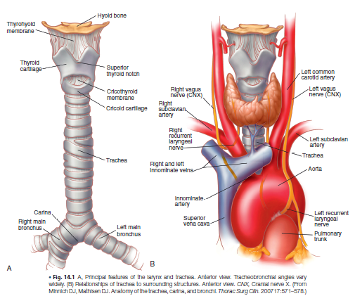

Slide 7
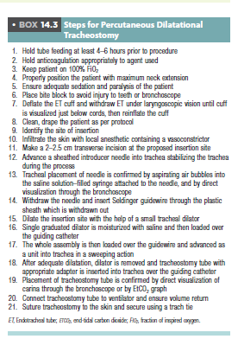

Slide 8
Organization of Care and Safety During Bedside Tracheostomy
Tracheostomy is one of the most hazardous procedures performed
in the ICU. Although intraprocedural complications are rare,
vascular injury resulting in hemorrhage, loss of airway control, or
airway injury is catastrophic and may rapidly result in death, with
rates as high as 75%27,28 for loss of airway control. It is prudent
to take appropriate precautions to avoid these problems or manage
them when they arise.

Slide 9
The first step is appropriate patient selection. There are few absolute contraindications and a small number of relative contraindications (described elsewhere in this chapter).
The development of a team approach and a safety checklist for bedside tracheostomy has been demonstrated to decrease complications.
This should include a well-trained lead physician and assistant; an airway management practitioner who is capable of reintubation if necessary and will manage the ventilator; a nurse or other provider to administer sedation and pain medication and monitor the patient’s clinical status; and a circulator who can run for supplies.
If bronchoscopic support is planned, a skilled bronchoscopist should be included. Some practitioners consider that such bronchoscopic assistance is required for PDT, but the literature does not support improved complication rates.
The bronchoscope should be available immediately for emergencies, even if not used
routinely.
Ultrasound has also been used as an adjunct to avoid vascular injury but it has not yet been demonstrated to be of benefit in this setting.
If the primary proceduralist is not a surgeon, it is appropriate to have surgical “backup” in the hospital. It is therefore wise to plan elective bedside tracheostomy during daytime
hours to ensure the availability of maximum personnel support in an emergency.

Slide 10
The equipment for the procedure should be in the room before starting, as well as any equipment that may be needed to deal with unplanned events. An assortment of tracheostomy tube sizes should be available as well as endotracheal tubes and laryngoscopes for reintubation.
If PDT is planned, a surgical tracheostomy tray should be in the unit, as well as equipment for cricothyrotomy should the need arise. Good lighting is essential and headlamps
may be of benefit.
The team should prepare for bedside percutaneous or surgical tracheostomy as they would for any operation. This includes discussion of the plan for sedation, the procedure itself, the roles of the team members, and any particular concerns regarding the individual
patient.
Structuring this practice with the use of a World Health Organization style checklist has been demonstrated to reduce complication rates significantly for bedside tracheostomy

Slide 11
Techniques
Percutaneous (Box 14.3)
PDT, also known bedside tracheostomy, is the placement of a tracheostomy tube. This technique uses a small skin incision and dilation of the subcutaneous tissue into the tracheal lumen without direct surgical visualization of the trachea.
It is considered minimally invasive and is often done at the bedside in the ICU, avoiding the
risks of transporting a critically ill patient and the costs of the operating room. PDT is done with continuous monitoring of the patient’s vital signs and often is performed under direct
bronchoscopic visualization

Slide 12
The most common technique used is the Ciaglia technique (Video
14-1). With this technique, there is no sharp dissection involved
beyond the skin incision. The patient is positioned and prepared
in the same way as for the standard operative tracheostomy. Deep
sedation is administered and all steps are done under bronchoscopic
vision. The endotracheal tube is withdrawn under bronchoscopic
guidance about 1 to 2 cm below the vocal cords to expose the
space below the first tracheal ring by using digital pressure at 2 cm
above the sternal notch while looking at the bronchoscopic view.
The incision site is selected to correspond to the space between
the second and third tracheal rings. Lidocaine 2% with epinephrine
is used for local anesthesia and then a 2-cm incision is made. The
pretracheal tissue is then cleared with blunt dissection. The operator
enters the tracheal lumen below the second tracheal ring with an
introducer needle through the incision (Fig. 14.2). The tract between
the skin and the tracheal lumen is then serially dilated over a
guidewire and stylet. A tracheostomy tube is placed under direct
bronchoscopic vision over a dilator. Placement of the tube is also
confirmed by visualizing the tracheobronchial tree through the

Slide 13
tracheostomy. The tracheostomy tube is then secured to the skin
with sutures and a tie or device encircling the neck.
Although there is a learning curve to the technique, there are several advantages of PDT. The time required for bedside PDT is considerably shorter than that for an open tracheostomy.
The elimination of operating room scheduling issues and costs, as well as the risks of transport, provide benefit to the patient and critical care team. In fact, the cost of performing PDT at the bedside is roughly half that of performing open surgical tracheostomy in the operating room.35

Slide 14
